Slide 1

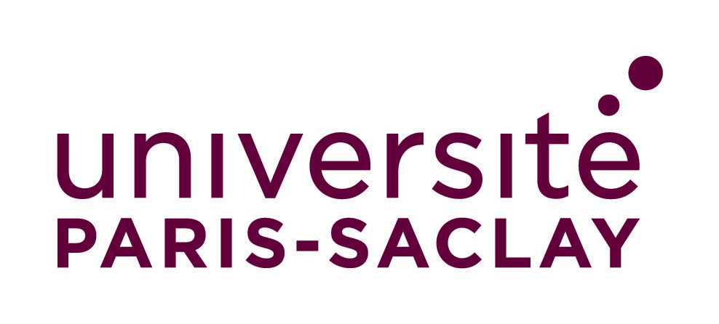

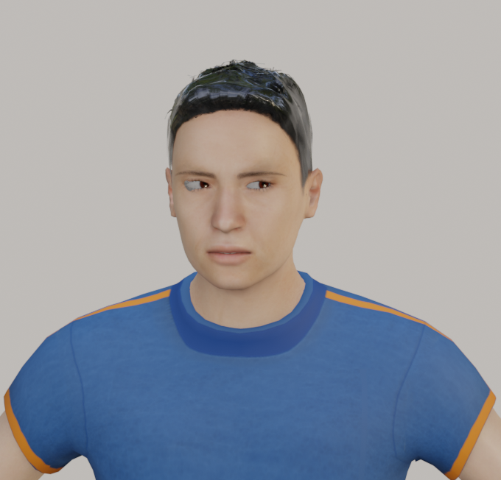

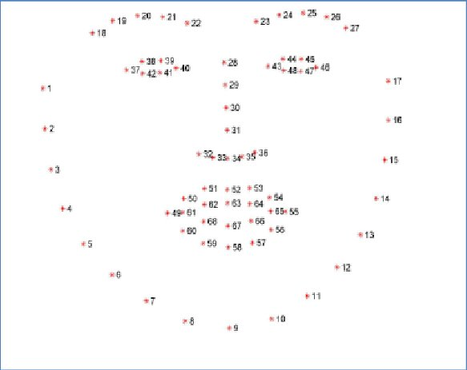
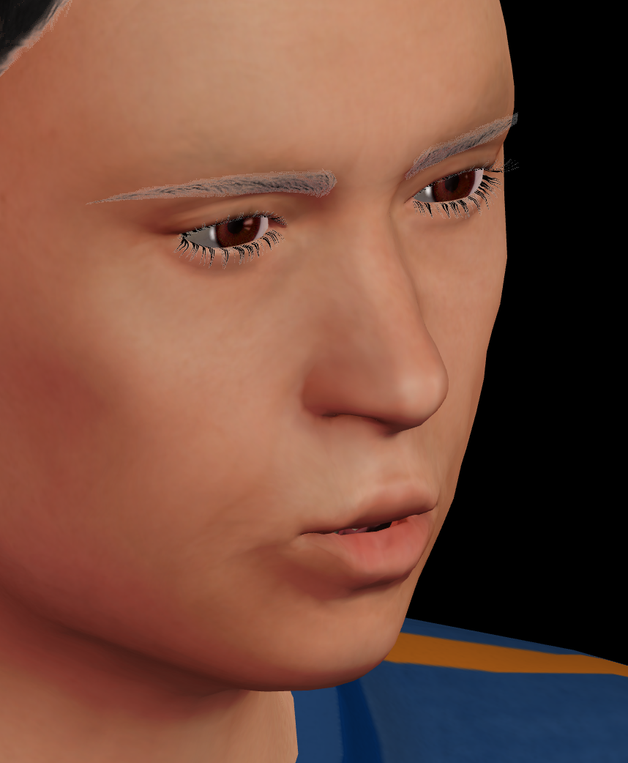
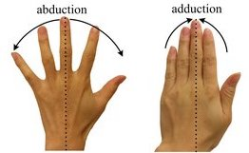
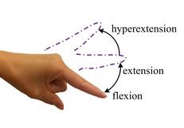
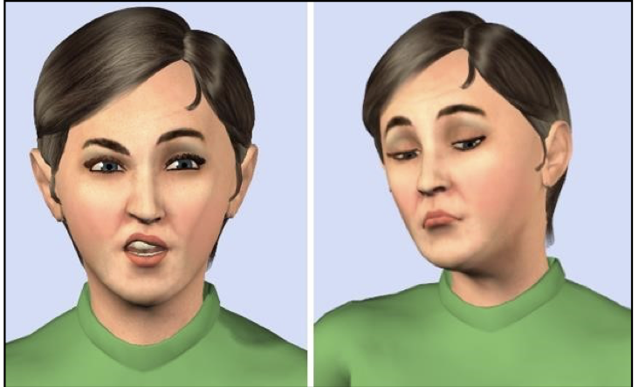
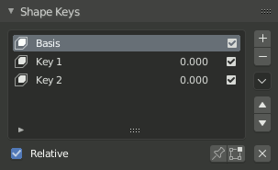
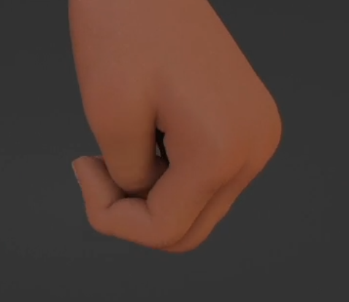
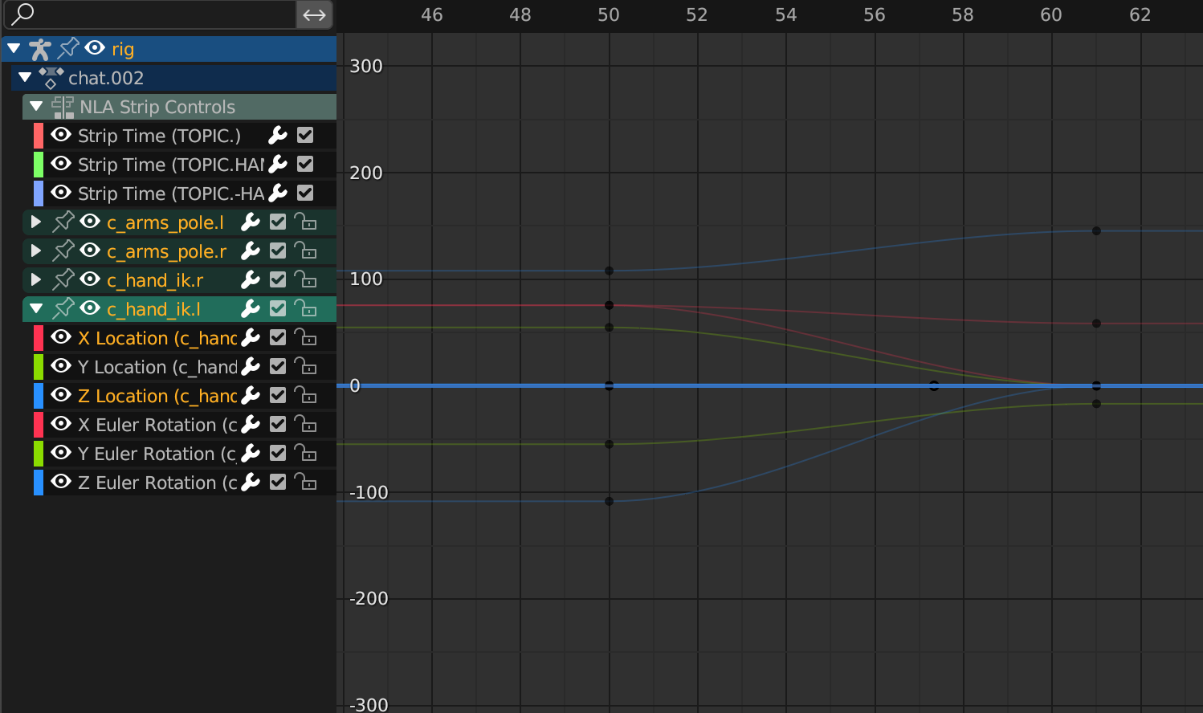
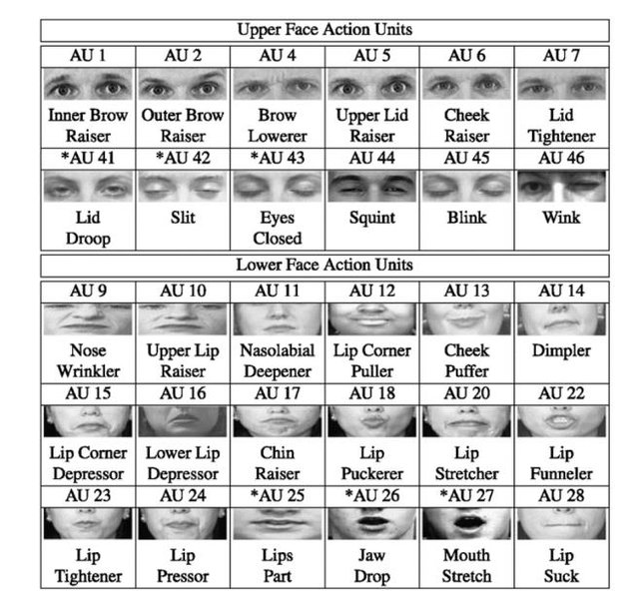
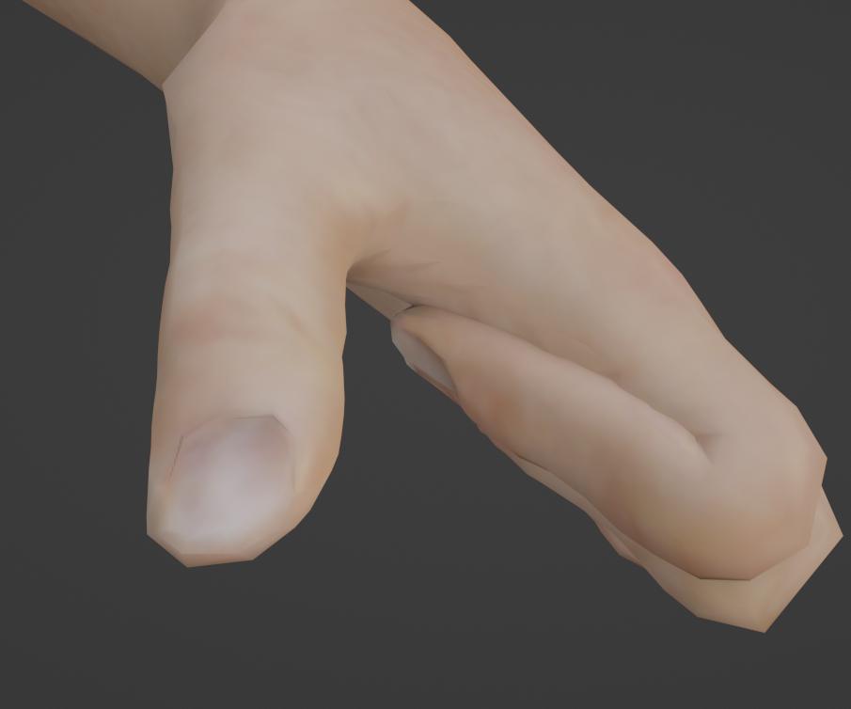
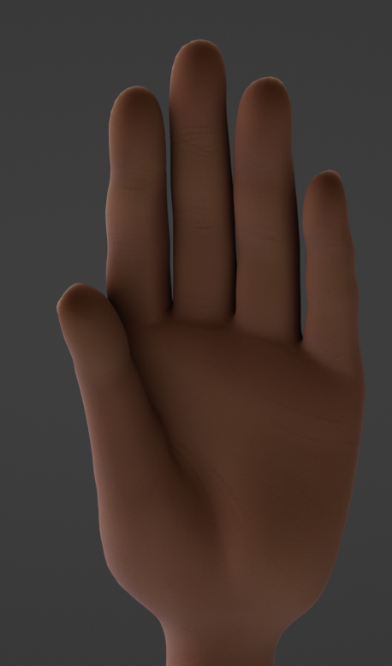
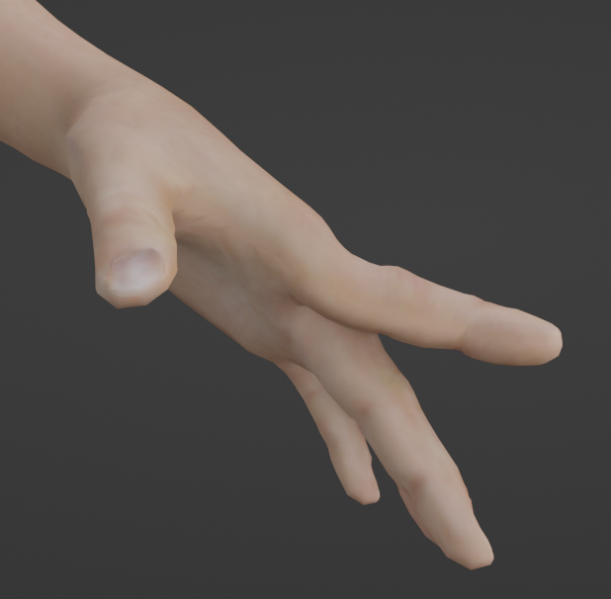
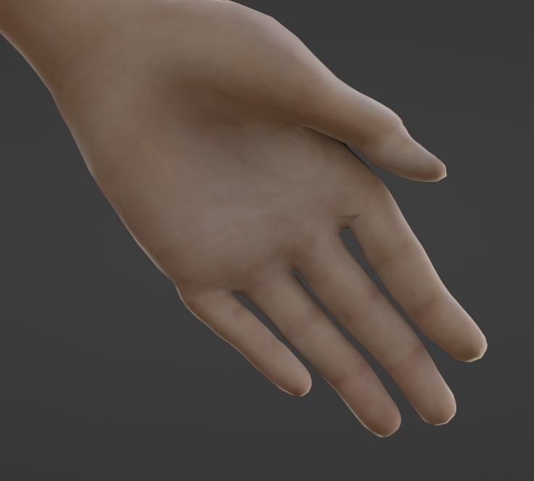
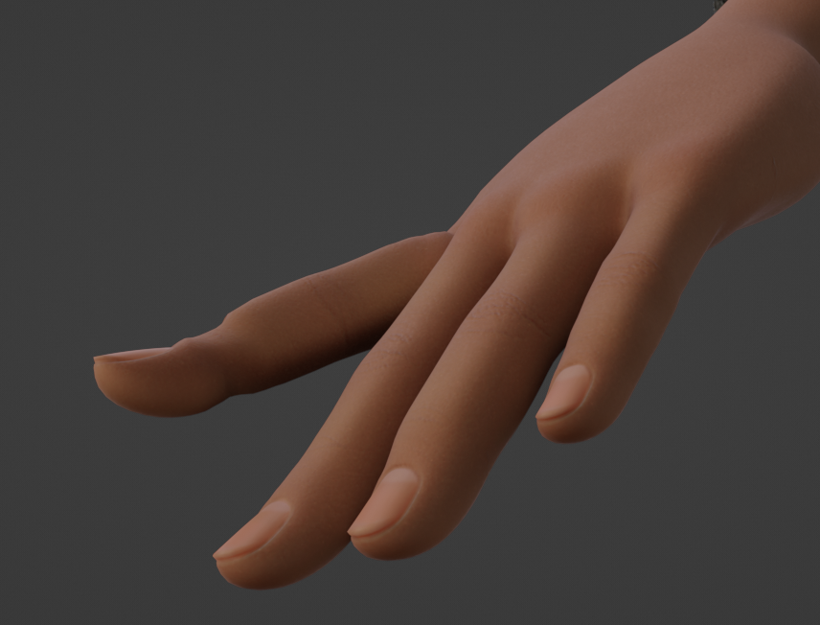
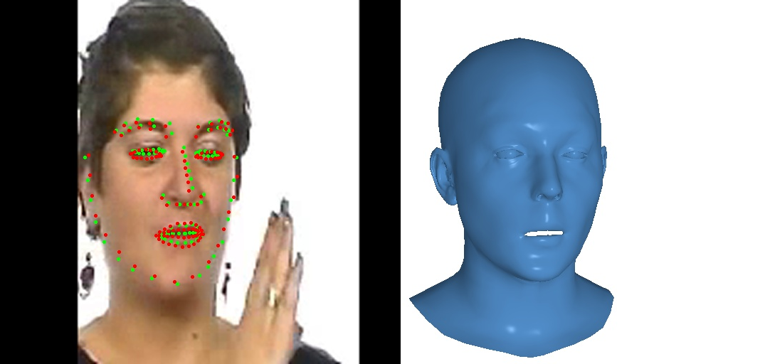


EXTENDING MORPHS IN AZEE USING POSE SPACE DEFORMATIONS
Paritosh Sharma, Michael Filhol
LISN, CNRS, Université Paris-Saclay, Orsay, France
paritosh.sharma@universite-paris-saclay.fr, michael.filhol@cnrs.fr
Objective: Enhancing the realism of signing avatars by developing a methodology for creating a set of morphs in the AZee language.
Methodology: Capturing both rigid and non-rigid shape changes, as well as facial expressions, by studying local avatar movements and incorporating a popular cognitive facial model
Results: Integration of the morphs with a parameterized 3D avatar model in a Blender add-on resulted in faster real-time synthesis and more realistic movements.
Significance: The proposed methodology contributes to the field of signing avatars by providing a more intuitive toolkit for AZee linguists, allowing them to create highly realistic and immersive signing avatars.
Abstract
Methodology
Conclusion
And
Future Work
AUs 51 to 60 and 61 to 69 not added
Morphs constraints in
morph ’morph id
weight [0 , 1]
We presented a methodology that successfully extends the low-level capabilities of AZee by integrating a new set of morphs.
This results in improved shapes, ease of posing for linguists, and faster run-time performance.
Limitations
Larger Use Cases: Such as spine extension, and head movements.
Low Coverage: More AUs such as Paula and larger coverage of facial expressions using FLAME.
Naturalness: modify the bezier handles of the underlying motion curves resulting in smoother and more natural transitions between poses.
Morphs which control the skeleton
Landmarks
Results
morph id | Movement
I closed | Hyperextension and Flexion of index fingers
M closed | Hyperextension and Flexion of middle fingers
R closed | Hyperextension and Flexion of ring fingers
L closed | Hyperextension and Flexion of little fingers
T closed | Hyperextension and Flexion of thumbs
palm extended | Adduction and Abduction of the palms
Introduction
Procedural synthesis of sign language involves generating animations for signing avatars based on a list of motion constraints.
AZee model enables the creation of custom sign language content without the need for pre-animated data. However, existing techniques using inverse kinematics (IK) or forward kinematics (FK) for shape configuration often produce unnatural or incorrect poses.
First Set of AZee Skeletal Morphs
Paula
Morphs which control the face
Shape Keys
orient
'dir
!index
L
2
'along
oppvect
dir
!palm
L
Problem with hand shapes
F-Curve calculation-based on motion templates
Improved hand shapes
FACS
FLAME
This work has been funded by the Bpifrance investment “Structuring Projects for Competitiveness” (PSPC), as part of the Serveur Gestuel project (IVe`s et 4Dviews Companies, LISN — University Paris-Saclay, and Gipsa- Lab — Grenoble Alpes University).

